Slide 1
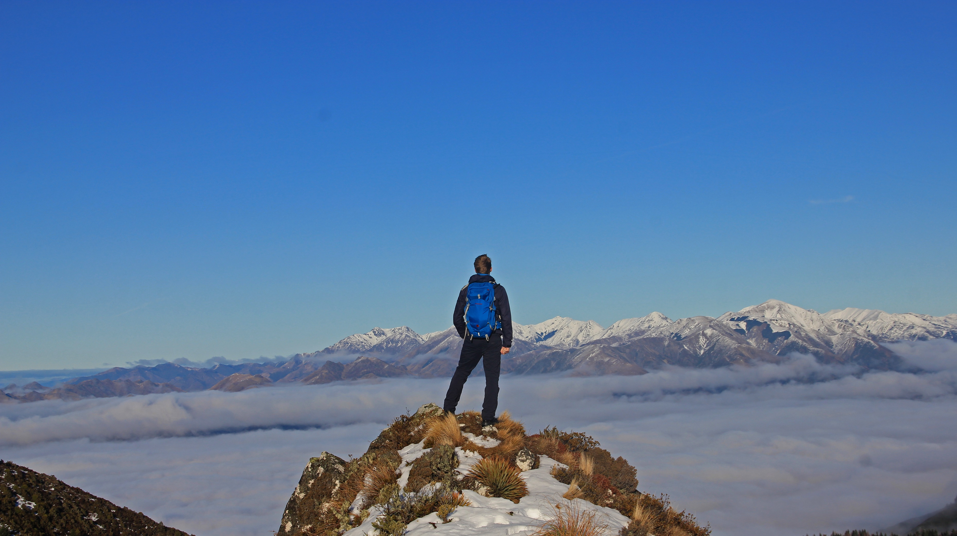

Conquer the world.
Plan your campaign today.
Notes:
Jan

Slide 2
Are you ready for (a) Perfect Time?
Perfect Time – Plan Your Trip
The planning tool for your perfect vacation

Slide 3

What to expect?
The idea
The project
The (application) design
The product
More @

Slide 4
What to expect?
What is Perfect Time?
Why would you use Perfect Time?
Who created Perfect Time? How did the team organize itself?
How much costs did Perfect Time accumulate?
What is the foundation of Perfect Time?
How was Perfect Time designed?
How is quality promoted and enforced?
Live Demo
Peering into the crystal ball

Slide 5
What is Perfect Time? The vision and the idea
“Our vision is to create a web application that will allow you to plan your trip by setting different locations or stages. Afterwards you can publish your trip and share it with your friends. They can use your plan as an outline for their own trip by simply importing your published data.”
Make planning your trip simple, flexible and intuitive
Make sharing your experiences easy
Allow using experience of those who came before you
More @
Notes:
SRS

Slide 6
Why would you use Perfect Time? The customer benefit
UVP, there is no other application with similar functionality
Running as a web application in any browser and on any device
Customizable by the user
Easy to monetize by advertising activities, location or even whole trips.
Cheap to maintain and easily scalable

Slide 7

Who created Perfect Time? The team and the RUP roles
Jan: Systems Analyst, Tester
Lea: Business Process Analyst, Tester, Project Manager
Lukas: Software Architect, Tester, Deployment Manager
Tim: Integrator, Process Engineer
More @

Slide 8
How did the team organize itself? Scrum and YouTrack
The project used Scrum.
Agile -> Weeklong sprints, quick to adapt
Clearly structured -> Swim lanes to organize tasks, RUP phases & workflows
Fast -> Breaking it down into small tasks, quick wins
We used RUP phases and Function Points for long-term planning.
The progress can be accessed through our YouTrack account: https://perfecttime.myjetbrains.com/youtrack/agiles
We published a weekly blog: https://perfecttime608150251.wordpress.com/
More @

Slide 9
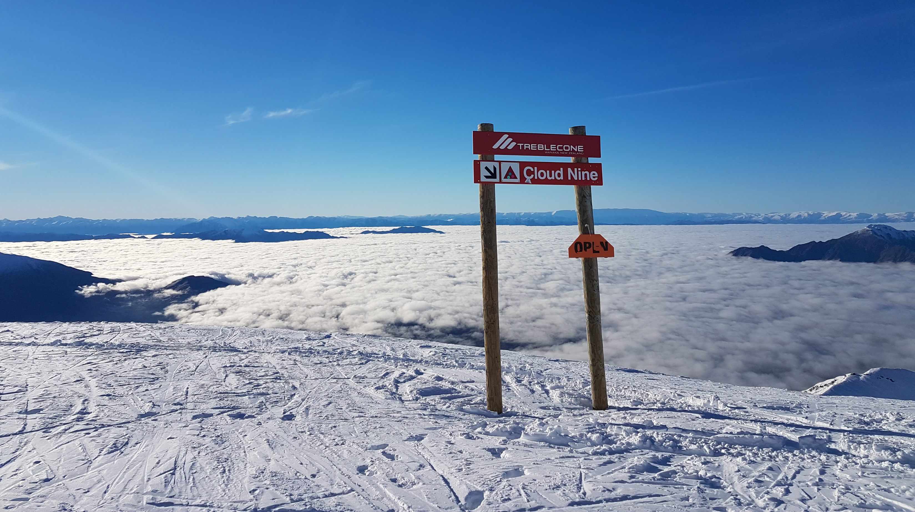
Plan your stay on Cloud Nine.
Notes:
Lukas

Slide 10
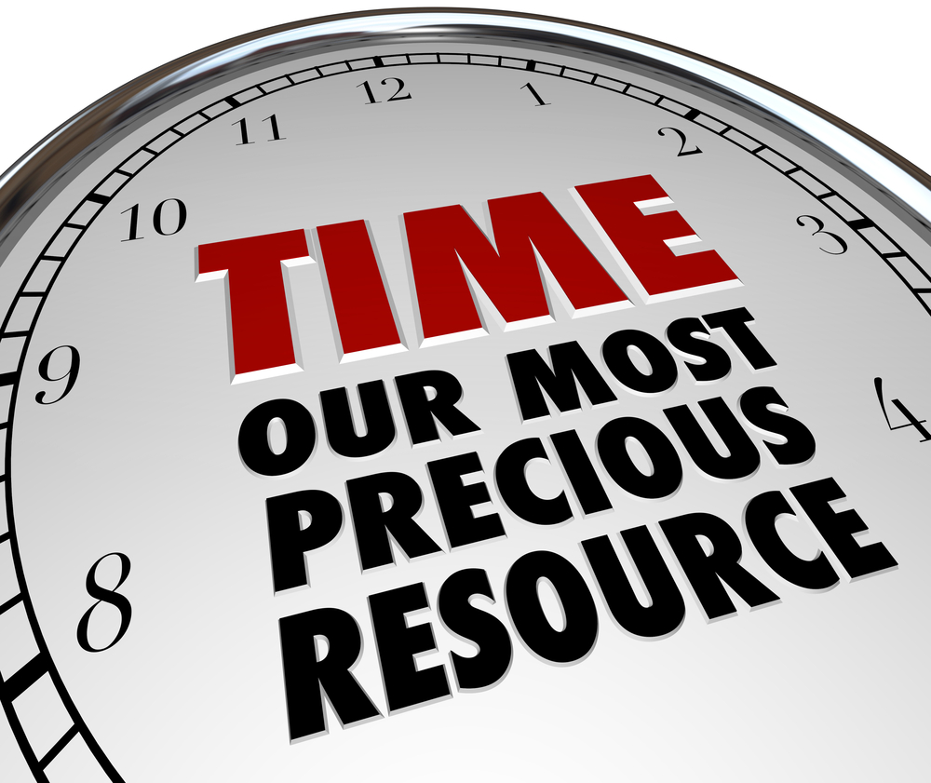
How much costs did Perfect Time accumulate?
Semester (only Use Case related tasks):
Hours estimated (LTP on FP): 56 (without any buffer)
Hours estimated (STP on YouTrack): 95
Hours needed (UC only): 104
Function Points: 110
Total Function Points implemented: 390
Total hours needed: 309 (for Use Cases), 690 (total)
More @
Notes:
FP/Cost Analysis
https://perfecttime.myjetbrains.com/youtrack/reports/time/145-7
https://perfecttime.myjetbrains.com/youtrack/reports/time/145-1
https://perfecttime.myjetbrains.com/youtrack/reports/time/145-3
"Dieses Foto" von Unbekannter Autor ist lizenziert gemäß CC BY-SA

Slide 11
What is the foundation of Perfect Time? React, Firebase and Redux
React Web Application
Deployed on Google Firebase
NoSQL-database running on Firebase
Components synchronized with Redux
More @
Notes:
SAD

Slide 12

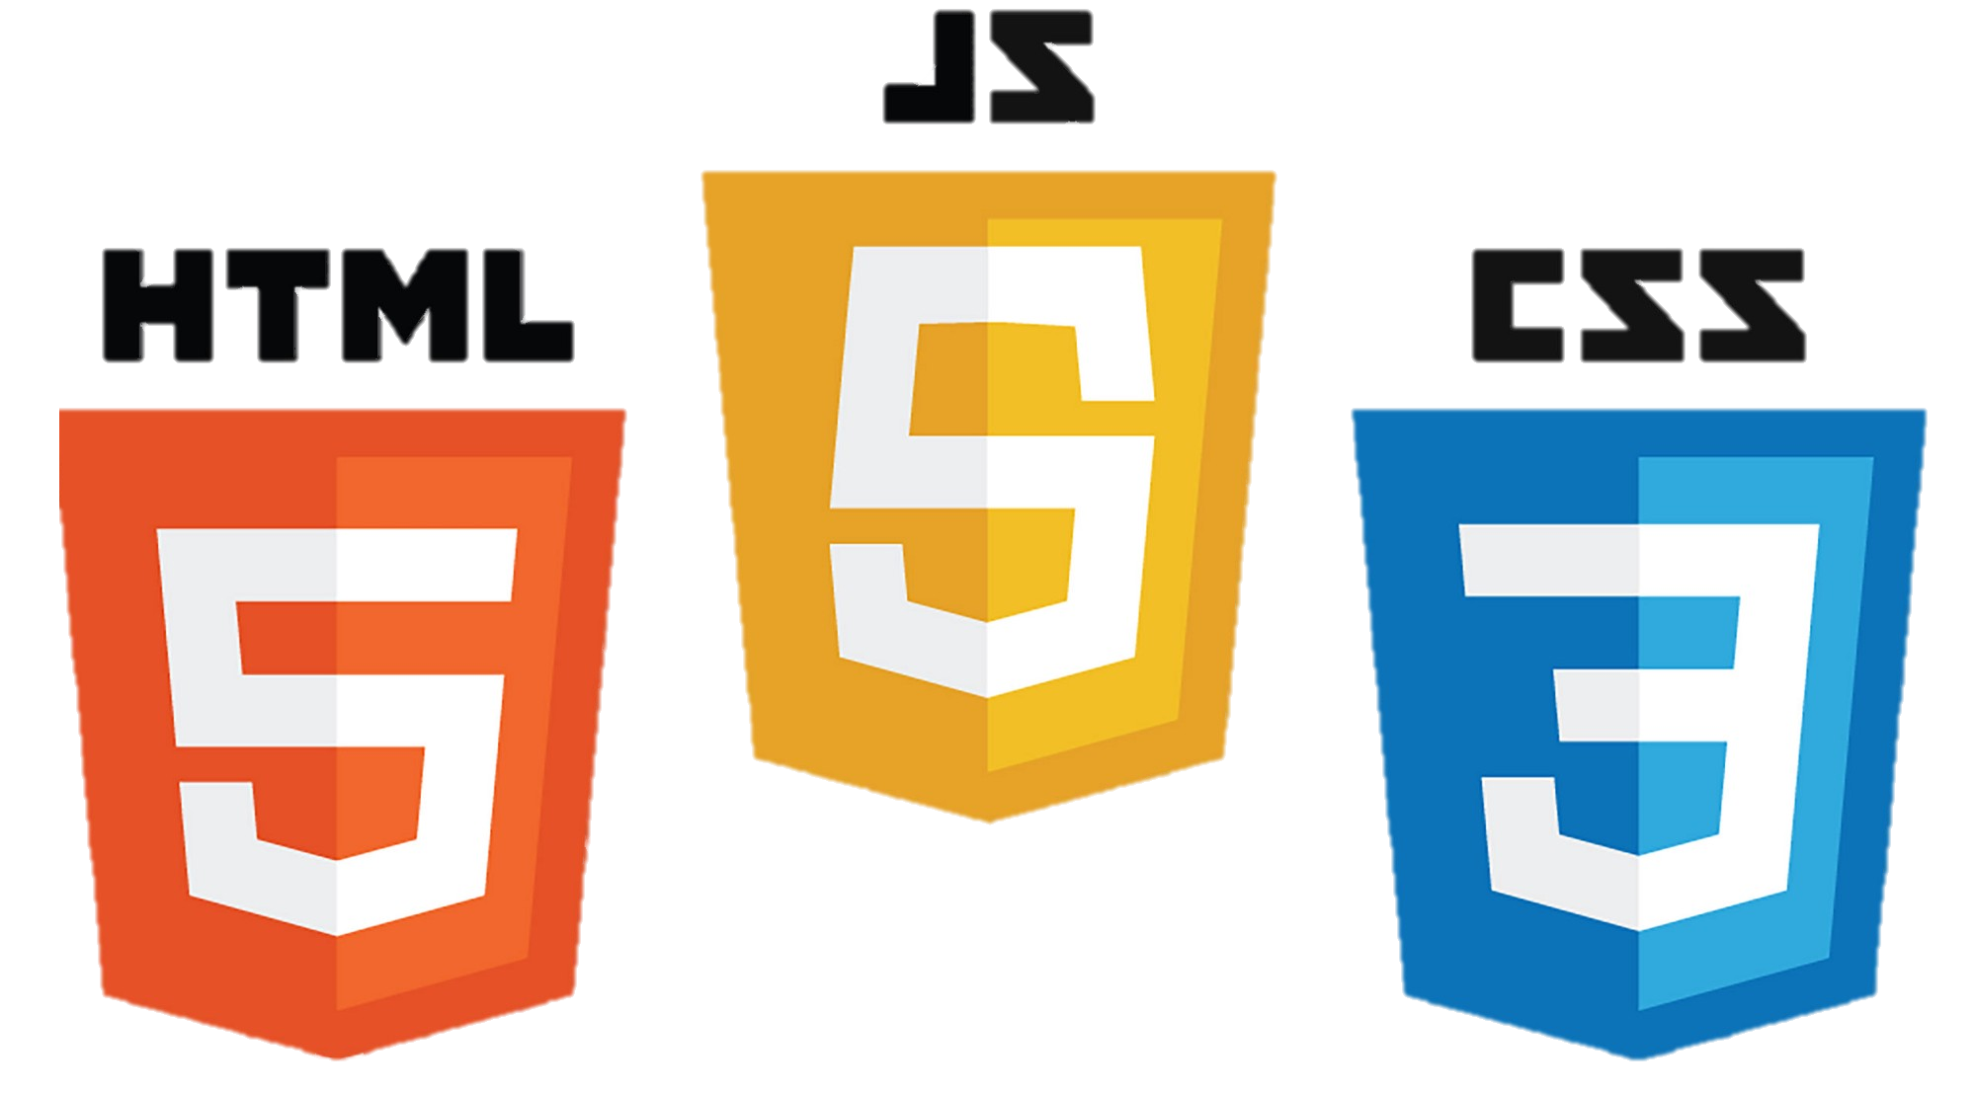








What is the foundation of Perfect Time? Tech Stack (I)
Frameworks / Dependencies
Languages
React
Redux
Firebase
Firestore (NoSQL)
Material UI
Node & NPM
HTML
CSS
JavaScript
TypeScript
YAML
Script languages
No class diagram
Notes:
SAD

Slide 13










What is the foundation of Perfect Time? Tech Stack (II)
Process & Documentation
Testing
Codacy
Codecov
Travis CI
GitHub
YouTrack
Wordpress
Jest
Faker
Cucumber
TestCafe
TSLint
Notes:
SRS, SAD, Test Plan

Slide 14
What is the foundation of Perfect Time? Tech Stack & Process
Sprint Planning
Coding
Committing
Testing
Merging
Deploying
Analyzing
Documenting
Reporting
Notes:
SRS, SAD, Test Plan

Slide 15
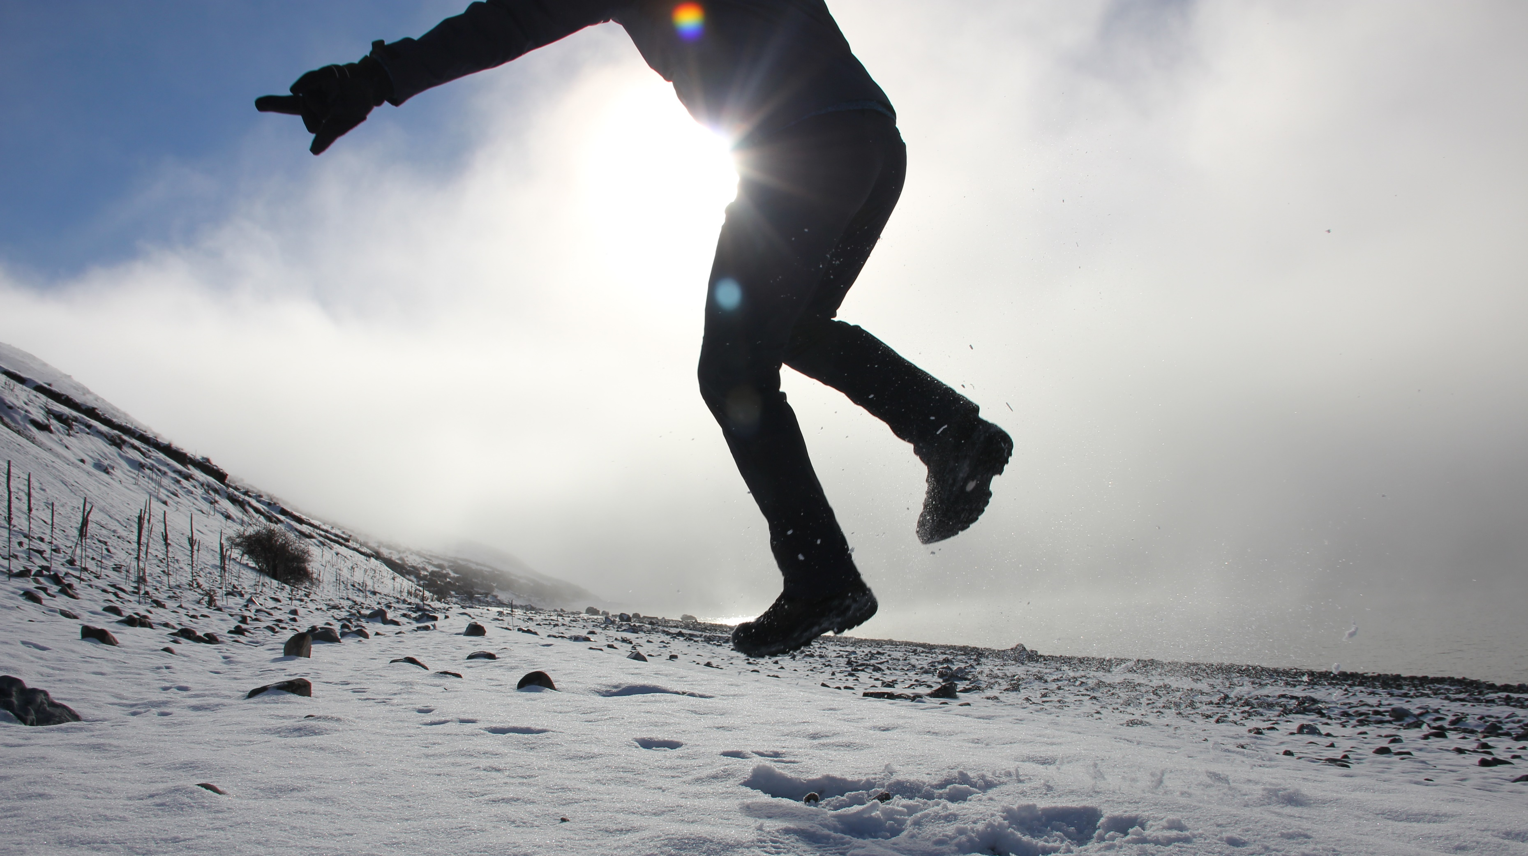
Find the place that makes your heart jump. Plan today.
Notes:
Tim

Slide 16
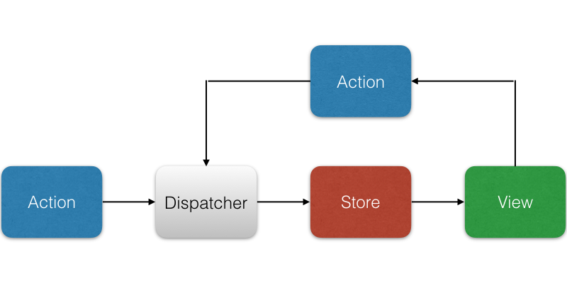
How was Perfect Time designed? React >> Flux architecture
More @
More @

Slide 17
How was Perfect Time designed? Container pattern
„A container does data fetching and then renders its corresponding sub-components. That’s it.“ – Jason Bonta
Container (page)
Worker (Input validator)
Component (button)
Component (activity card)
Component (Image field)
Easy to maintain & extend
More @
Notes:
SAD

Slide 18
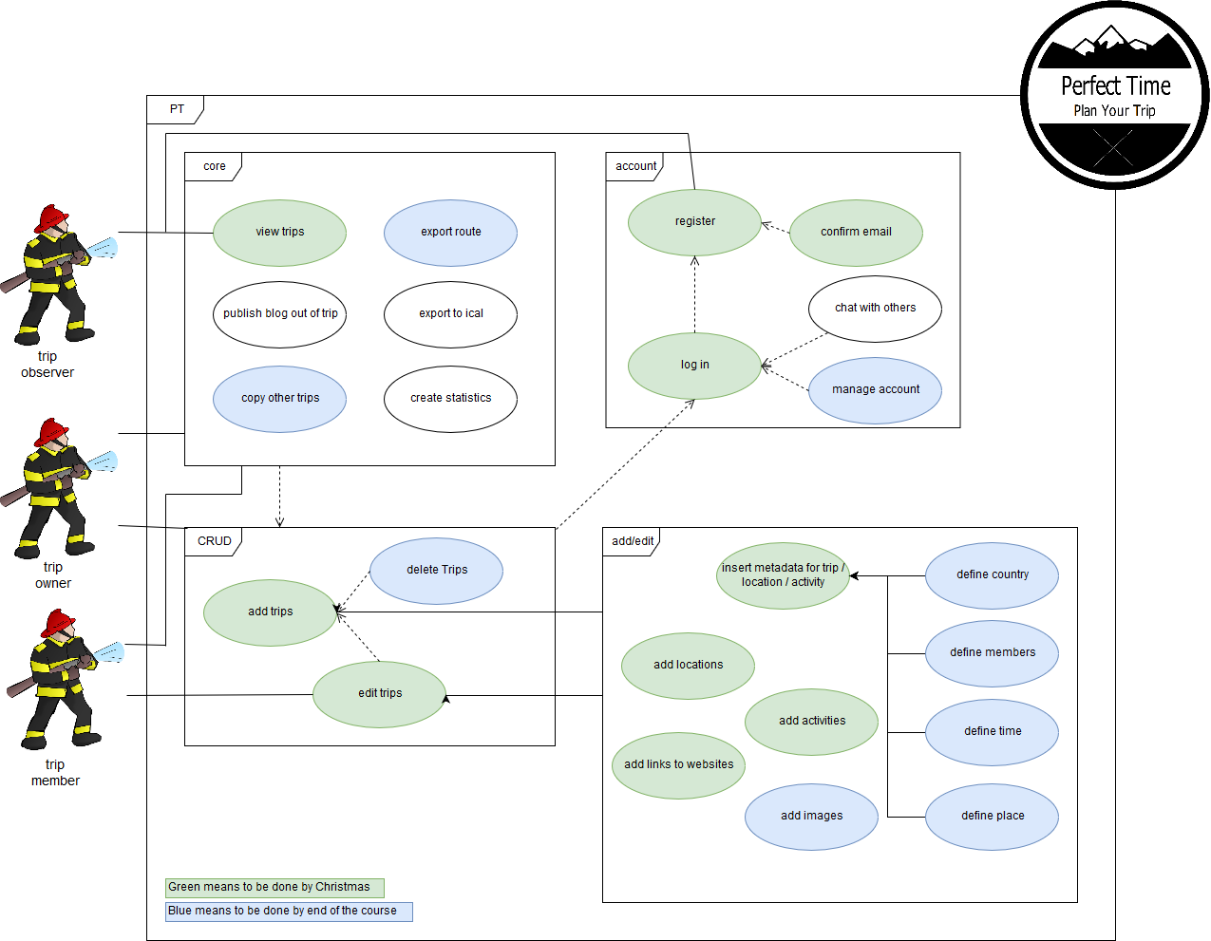
How was Perfect Time designed? Use Cases
More @
Notes:
Use Cases, SRS

Slide 19
How was Perfect Time designed? Use Cases

Slide 20
How was Perfect Time designed? Use Cases

Slide 21
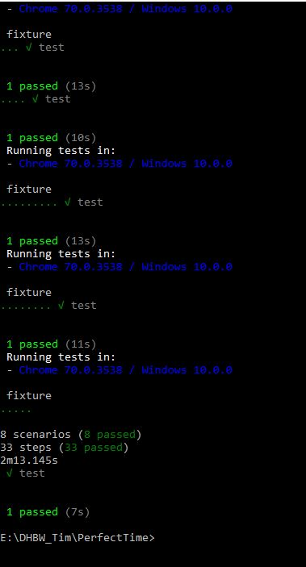
How is quality promoted and enforced? Merge Requests, Feature testing
Simple Rule: Merge through pull requests and test before you merge.
Work on different branches to keep other implementations safe.
We use Cucumber JS and TestCafe to test the whole application.
More @
More @
Notes:
Test Plan

Slide 22
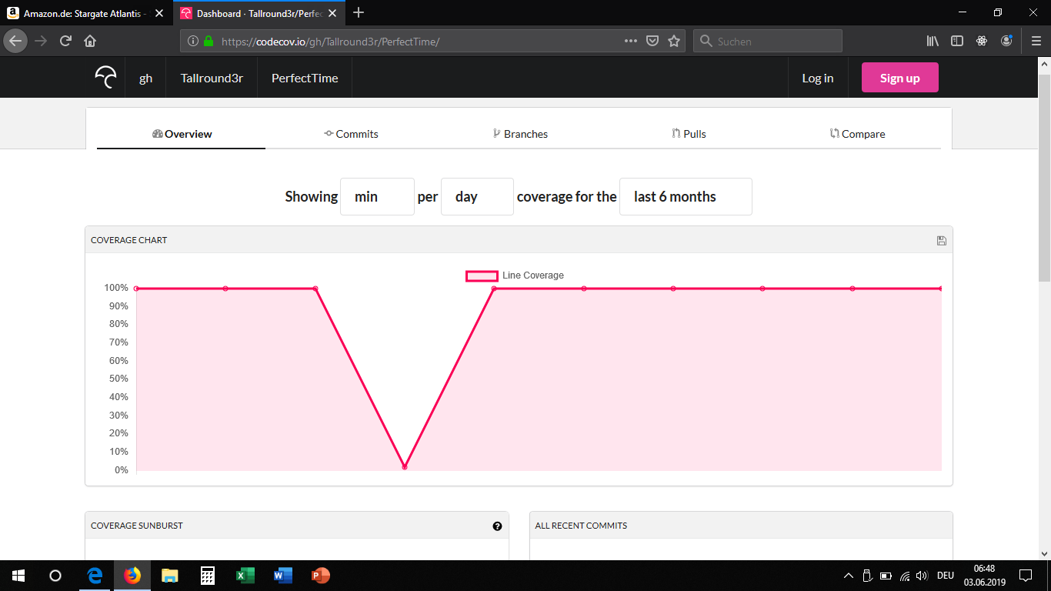
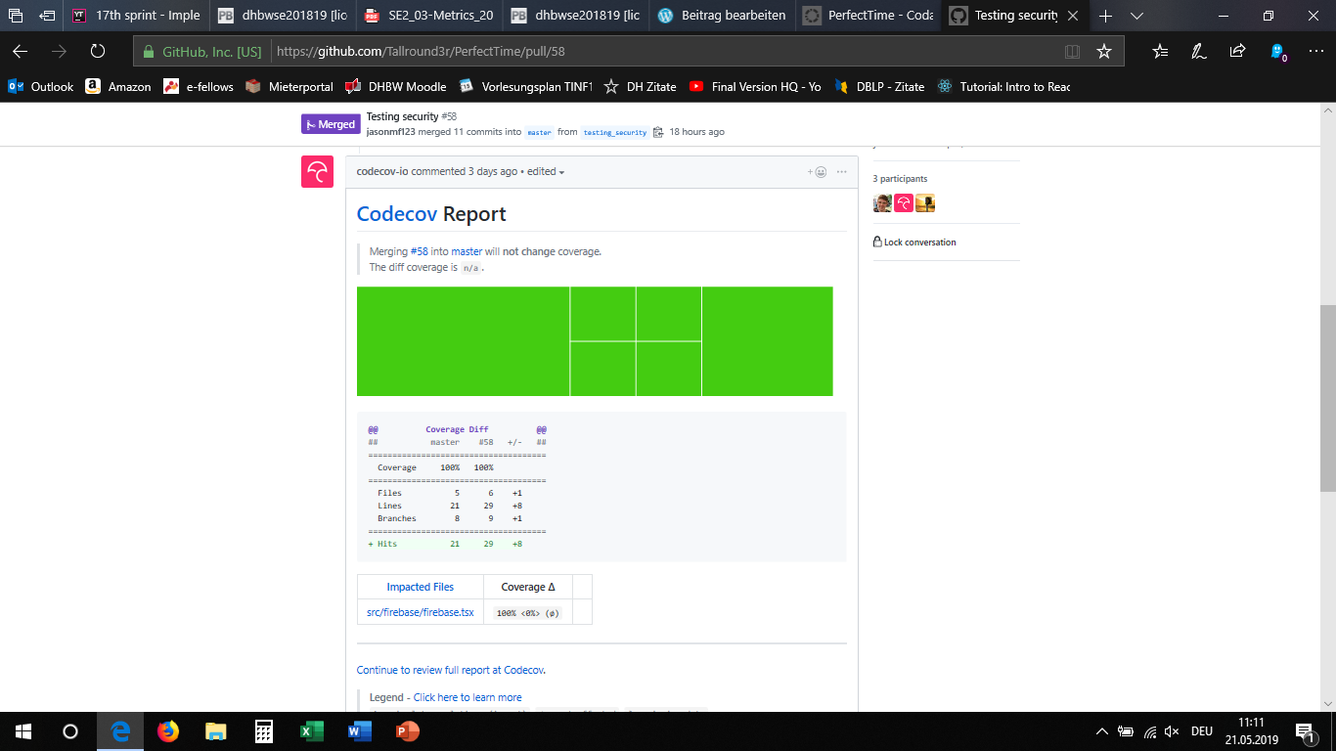
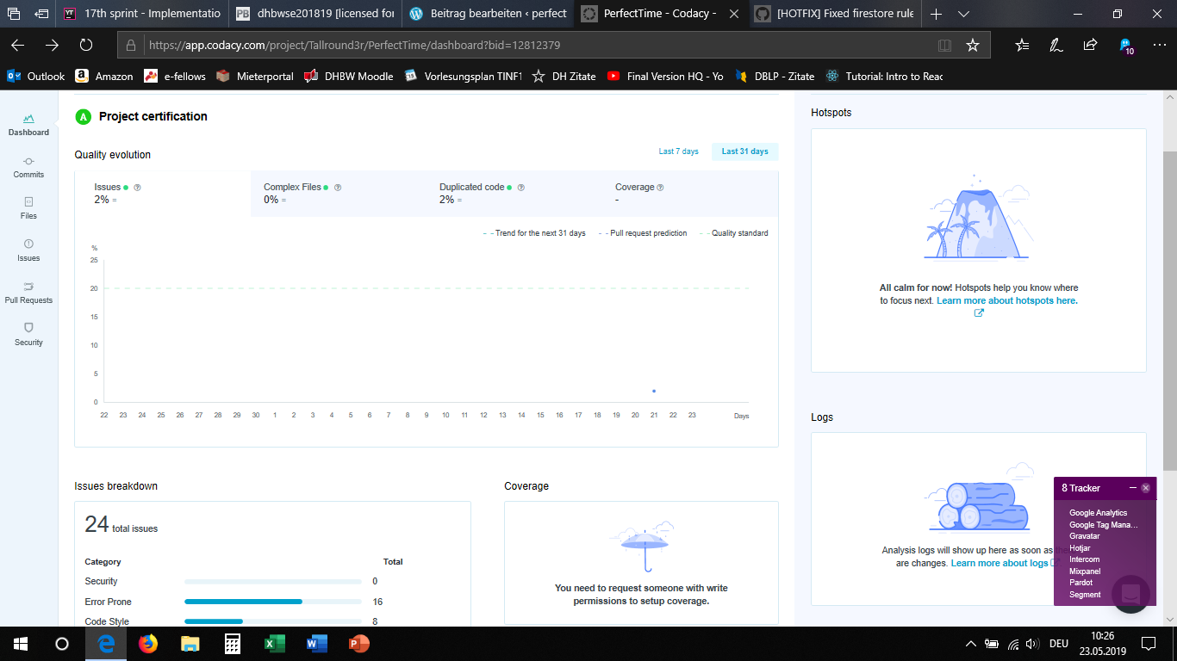
How is quality promoted and enforced? Unit testing, Continuous Integration, Risk Mgmt.
We use Jest JS (unit) tests to assess our logic.
This includes security testing.
Test Coverage (Codecov): 100%
Continuous Integration and Automated Deployment with Travis CI.
Code Quality enforced with metrics and Codacy (Grade A).
Proactive Risk Management (buggy product -> use Jest/Cucumber)
More @
More @
Notes:
Test Plan

Slide 23

Learn chilling from the pros.
Add the “activity“ today.
Notes:
Lea

Slide 24
Live demonstration

Slide 25
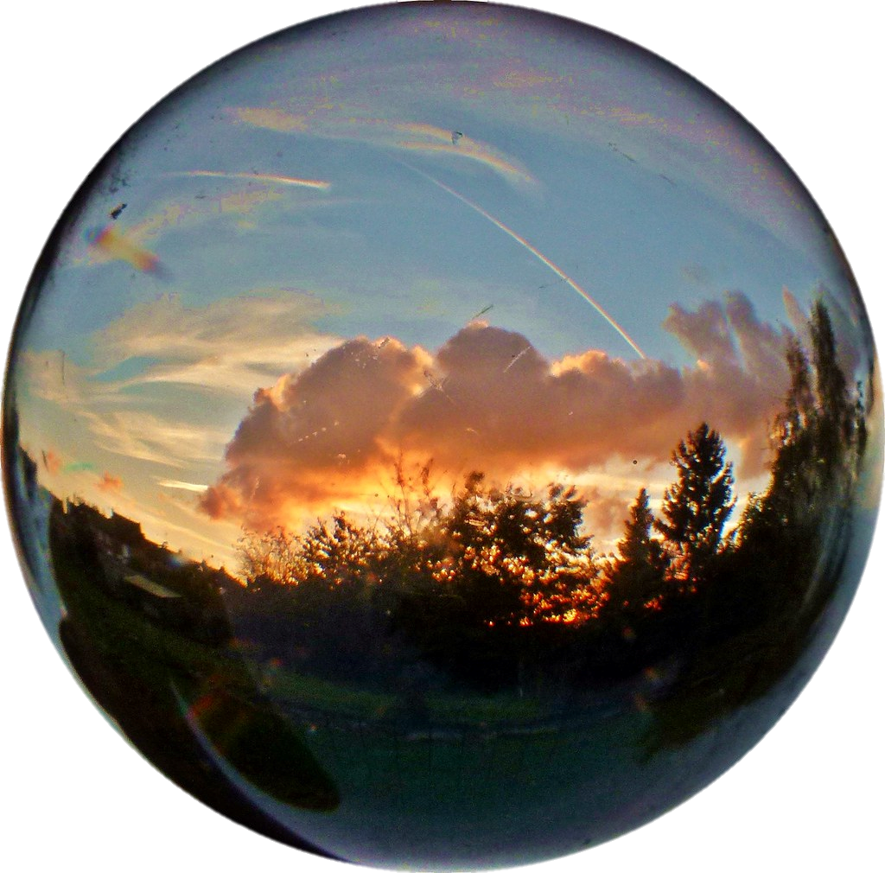
Peering into the crystal ball – Potential Add-ons
Turn trip into a blog
Fully customizable fields
Export / (Re-)Import trip
Export to ical
Export route to Google maps
Groups, chat, newsfeed
More @
Notes:
"Dieses Foto" von Unbekannter Autor ist lizenziert gemäß CC BY-SA-NC

Slide 26
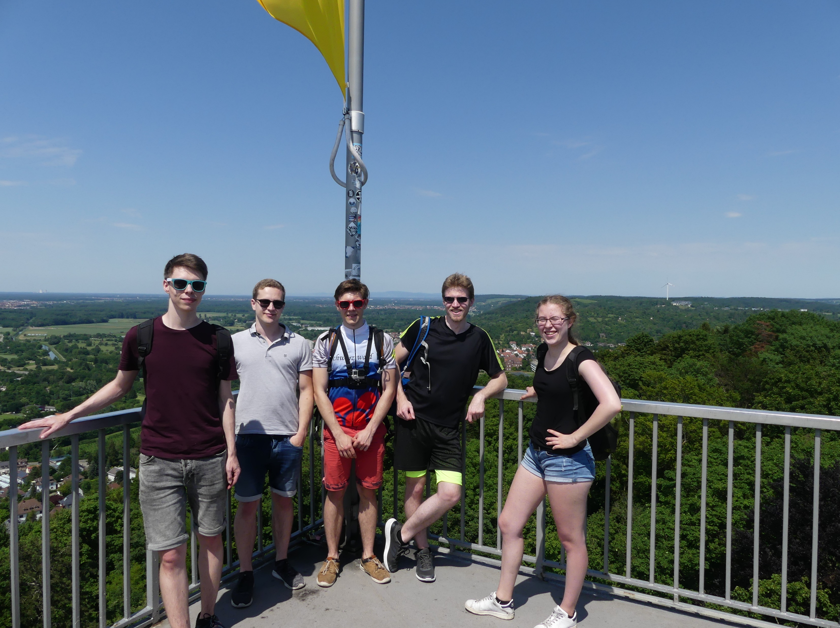
Make every time a Perfect Time.
Plan Your Trip today!

Slide 27
Thank you for your attention!
And have a Perfect Time.

Slide 28

Time for a Perfect advertisement clip ;-)

